Slide 1

Student Stress Level Detection Using Machine Learning
This presentation explores the development and application of a machine learning model for detecting and categorizing stress levels in students. We will delve into the methodology, architecture, and performance of the system.

Slide 2

Introduction
Student Stress: A Growing Concern
Student stress affects academic performance, mental health, and overall well-being. It's often caused by academic pressure, social anxieties, and financial worries.
Our Solution: A Machine Learning Model
We aim to develop a system to predict stress levels based on various indicators, providing insights for proactive support.

Slide 3

Technologies Used
The project leverages various technologies to build a robust and efficient solution.
Language
Python
Machine Learning Library
Scikit-learn
Data Visualization Library
Matplotlib, Seaborn
Web Framework
Streamlit
Database
Pandas & NumPY

Slide 4

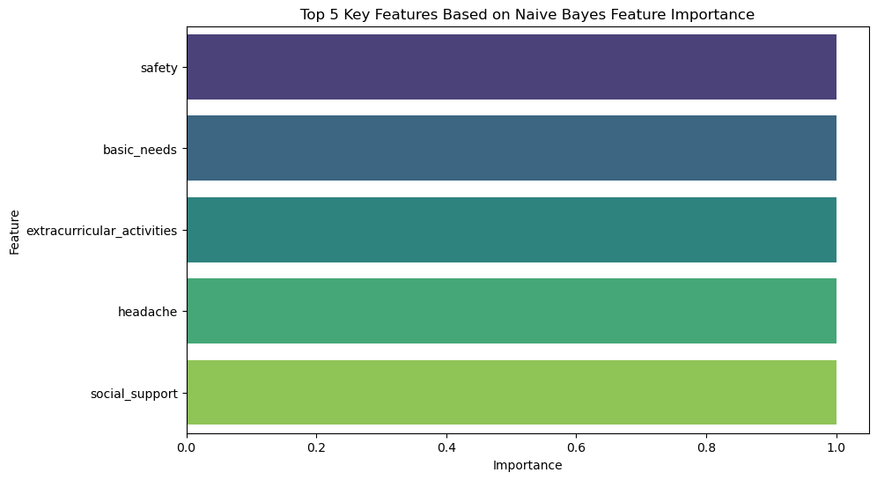
Dataset Overview
Dataset Source
Our dataset was obtained from Kaggle, a platform for sharing public datasets.
Link: https://www.kaggle.com/datasets/rxnach/student-stress-factors-a-comprehensive-analysis
Key Features
The dataset includes features like anxiety, depression, noise levels, and academic performance, allowing for a comprehensive analysis of stress indicators. The given bar graph gives the top 5 features for prediction.

Slide 5

Methodology
1
Data Collection
Gathering relevant data on student stress from various sources like surveys, interviews, and academic records.
2
Exploratory Data Analysis (EDA)
Analyzing the data to identify trends, patterns, and relationships between stress indicators.
3
Model Training
Training machine learning models like Random Forest, SVM, and Naive Bayes on the collected data.
4
Model Evaluation
Evaluating the performance of trained models using metrics like accuracy, precision, and recall.

Slide 6
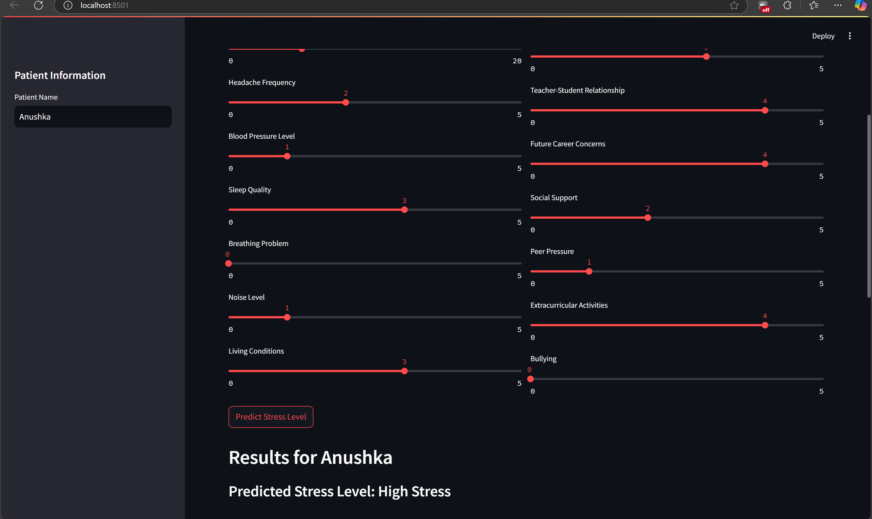
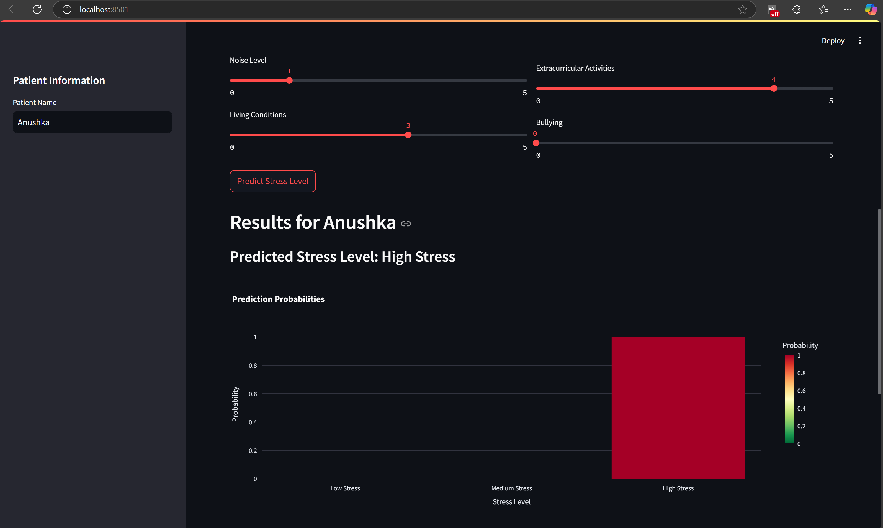
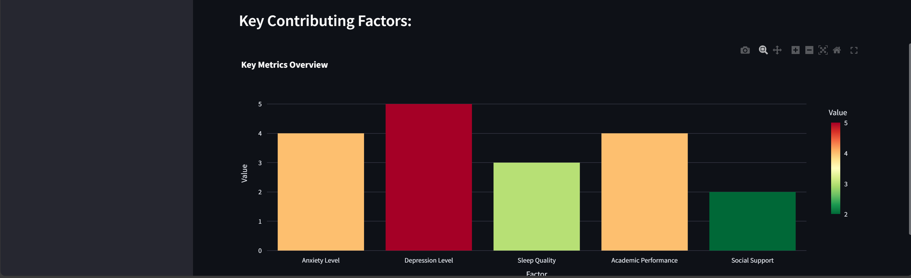



System Architecture
Input
Model Processing
Output
User input includes various stress indicators, such as anxiety levels, sleep patterns, and academic performance.
The machine learning model analyzes the input data and predicts the stress level based on the trained patterns.
The system outputs a stress level classification (low, medium, high) and personalized recommendations for support.

Slide 7
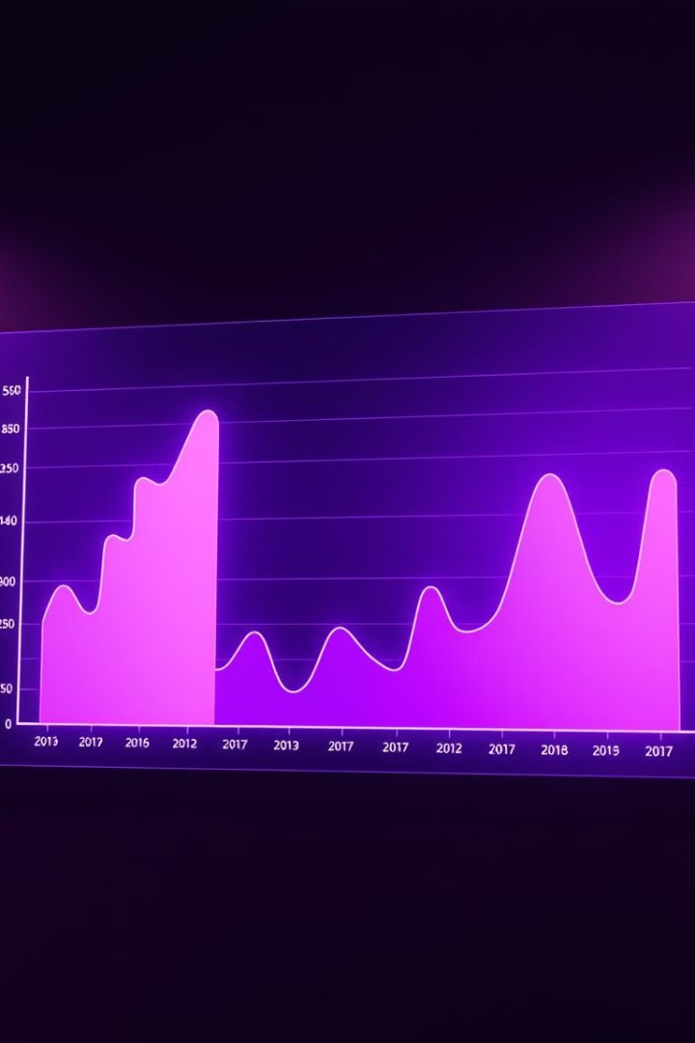
Model Performance
87%
Random Forest
Achieved the highest accuracy with 87%, demonstrating its effectiveness in predicting student stress.
89%
SVM
A strong performer with 89% accuracy, showcasing its ability to classify stress levels accurately.
90%
Naive Bayes
A reliable model with 90% accuracy, proving its potential in stress prediction.

Slide 8
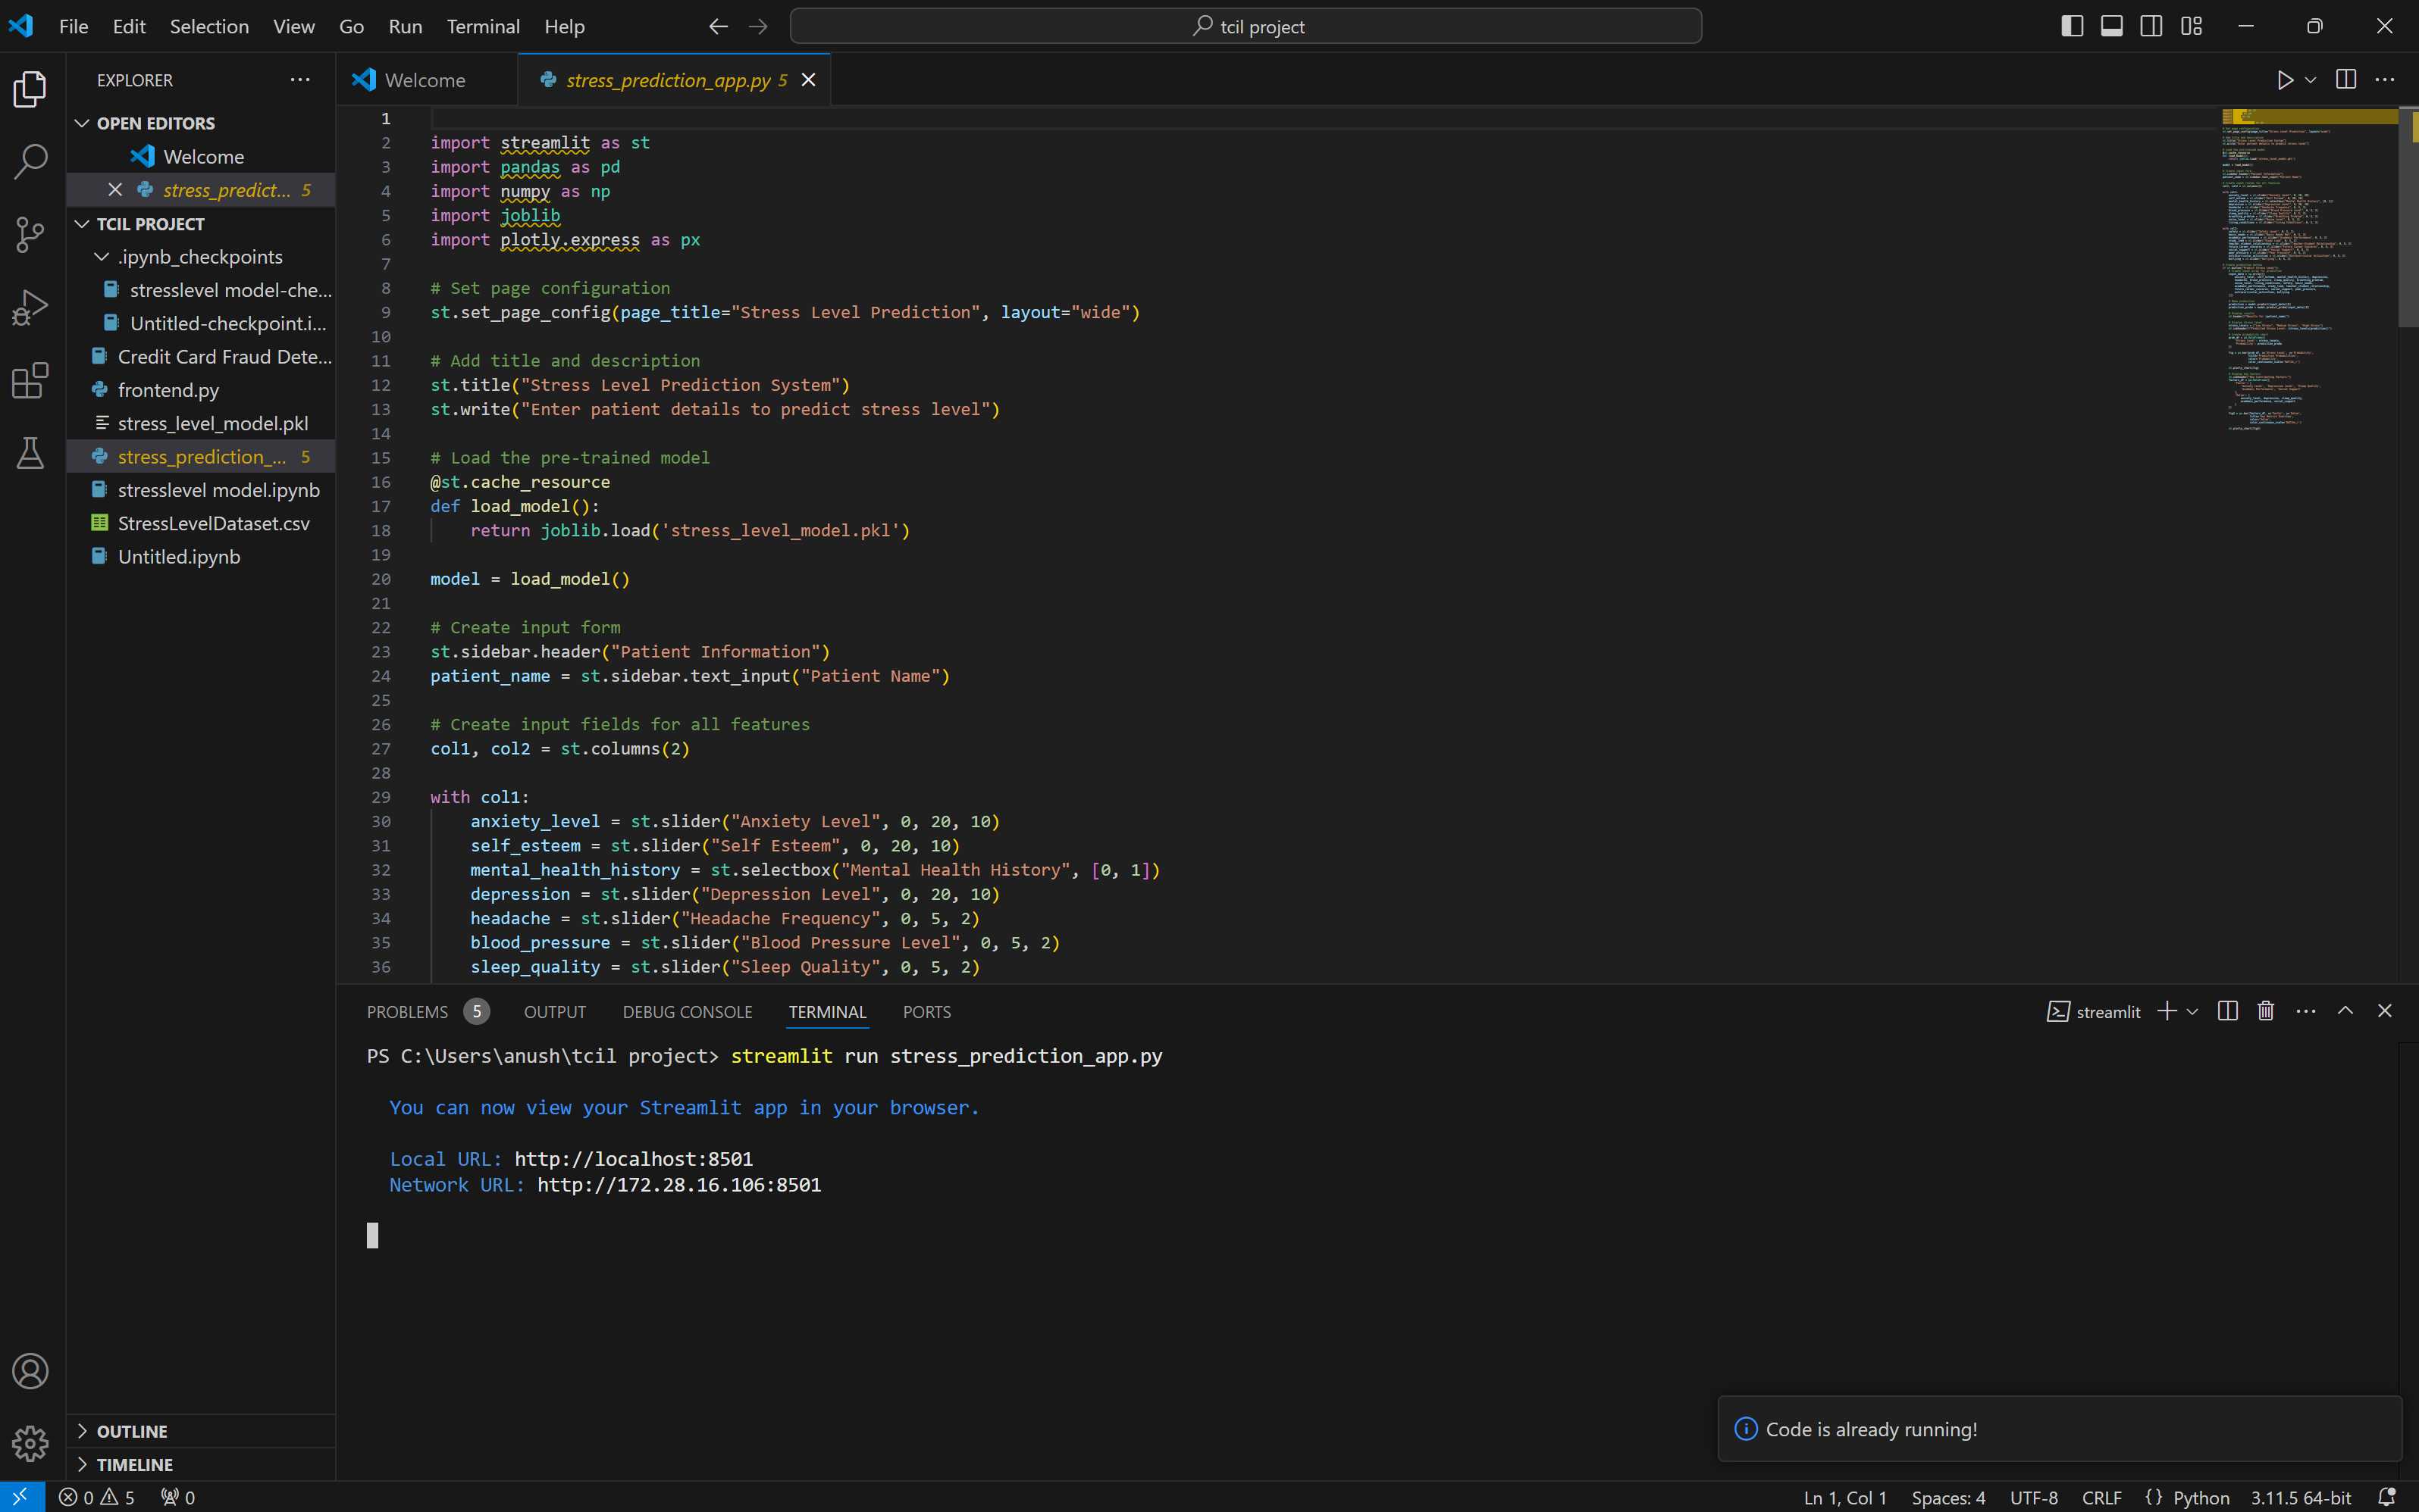
Streamlit Application
Interactive User Interface
Our Streamlit application provides a user-friendly interface for inputting stress indicators.
Real-Time Results
The application delivers instant stress level predictions and personalized insights based on the model's analysis.

Slide 9

Applications & Future Scope
Applications
Future Scope
The system can provide valuable support to educators and counselors in identifying students at risk of stress and providing targeted interventions.
We envision expanding the system to include real-time monitoring using wearable technology and developing broader applications for various populations.

Slide 10

Conclusion
This machine learning model offers a promising approach to effectively predicting student stress, empowering educators and counselors to provide proactive mental health solutions. We aim to further enhance the system's capabilities and expand its reach for a wider impact.

